Slide 1
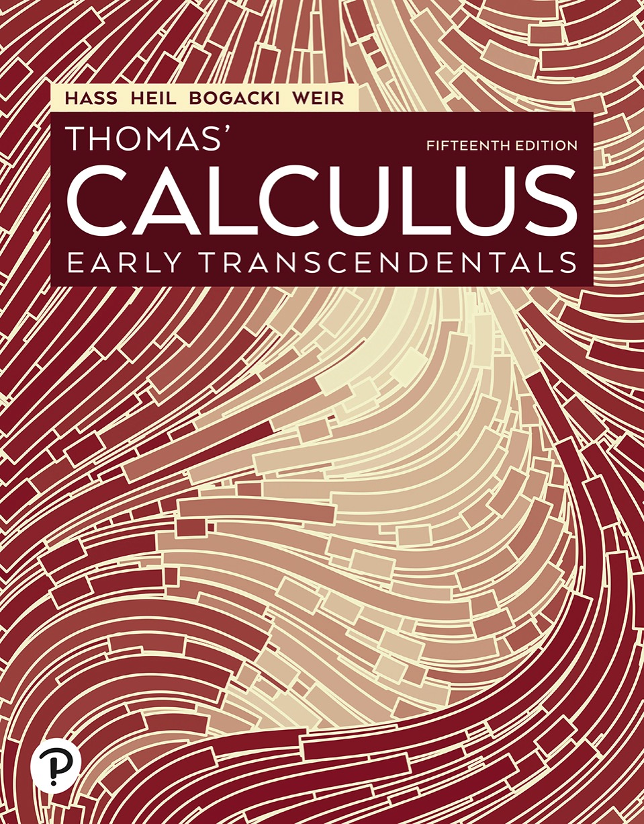

Thomas’ Calculus: Early Transcendentals
Fifteenth Edition
Chapter 13
Vector-Valued Functions and Motion in Space
Copyright © 2023, 2018, 2014 Pearson Education, Inc. All Rights Reserved
Notes:
If this PowerPoint presentation contains mathematical equations, you may need to check that your computer has the following installed:
1) MathType Plugin
2) Math Player (free versions available)
3) NVDA Reader (free versions available)

Slide 2
Section 13.1 Curves in Space and Their Tangents

Slide 3
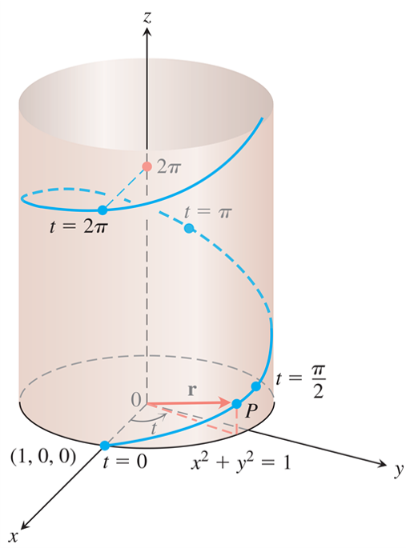
Curves in Space and Their Tangents (1 of 4)
The upper half of the helix
Notes:
Five points marked on the curve from bottom to top are as follows. The first point is at (1, 0, 0) labeled, t = 0. The second point is labeled, P, with a vector r pointing from the origin. The third point slightly above point P is labeled, t = start fraction pi over 2 end fraction. The fourth point is at t = pi. The fifth point is at t = 2 pi.

Slide 4
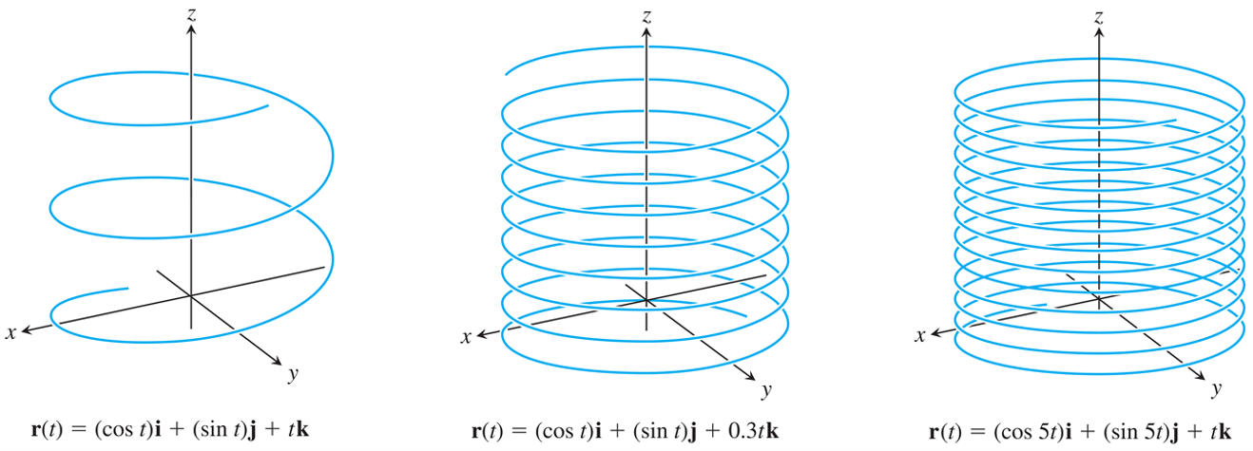
Curves in Space and Their Tangents (2 of 4)
Helices spiral upward around a cylinder, like coiled springs.
Notes:
The curve on the left displays the helix for r of t = left parenthesis cosine of t right parenthesis i + left parenthesis sine of t right parenthesis j + t k. This helix has completed 2 turns around the z axis. The curve in the center displays the helix for r of t = left parenthesis cosine of t right parenthesis i + left parenthesis sine of t right parenthesis j + 0.3 t k. This helix has completed 7 turns around the z axis. The curve on the right displays the helix for r of t = left parenthesis cosine of 5 t right parenthesis i + left parenthesis sine of 5 t right parenthesis j + t k. This helix has completed 12 turns around the z axis.

Slide 5
Curves in Space and Their Tangents (3 of 4)
Example: Graph the vector function
Solution: This vector function
is defined for all
real values of t. The curve traced by r winds around
the circular cylinder
The curve lies on the
cylinder because the i- and j-components of r, being the x- and y-coordinates of the tip of r, satisfy the cylinder’s equation:

Slide 6
Curves in Space and Their Tangents (4 of 4)
Solution (concluded):
The curve rises as the k-component z = t increases.
Each time t increases by
the curve completes
one turn around the cylinder. The curve is called a helix (from an old Greek word for “spiral”). The equations
parametrize the helix. The domain is the largest set of points t for which all three equations are defined, or
for this example.

Slide 7
Limits and Continuity (1 of 3)
Definition: Let
be a vector
function with domain D, and let L be a vector. We
say that r has limit L as t approaches
and write
if, for every number
there exists a
corresponding number
such that for all

Slide 8
Limits and Continuity (2 of 3)
Example: If

Slide 9
Limits and Continuity (3 of 3)
Definition: A vector function
is continuous
at a point
in its domain if
The function is continuous if it is continuous at every point in its domain.

Slide 10
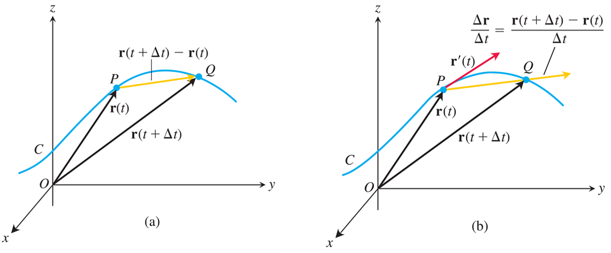
Derivatives and Motion (1 of 7)
As
the point Q approaches the point P
along the curve C. In the limit, the vector
becomes the tangent vector
Notes:
The graphs are as follows. Graph a, displays a curve C passing through two points, P and Q. A vector from the origin to point P is labeled, r of t. Another vector from the origin to point Q is labeled, r of start expression t + delta t end expression. A vector extends from point P to Q, and is labeled, r of start expression t + delta t end expression minus r of t. Graph b is similar to graph a. A vector extends from P through Q and is labeled, start fraction delta r over delta t end fraction = start fraction r of start expression t + delta t end expression minus r of t over delta t end fraction. Another vector extends from point P and is labeled, r prime of t.

Slide 11
Derivatives and Motion (2 of 7)
Definition: The vector function
has a derivative (is
differentiable) at t if f, g, and h have derivatives at
t. The derivative is the vector function

Slide 12
Derivatives and Motion (3 of 7)
Definitions: If r is the position vector of a particle moving along a smooth curve in space, then
is the particle’s velocity vector, tangent to the curve. At any time t, the direction of v is the direction of motion, the magnitude of v is the particle’s speed,
and the derivative
when it exists, is the particle’s
acceleration vector. In summary,

Slide 13
Derivatives and Motion (4 of 7)
1. Velocity is the derivative of position:
2. Speed is the magnitude of velocity:
3. Acceleration is the derivative of velocity:
4. The unit vector
is the direction of motion
at time t.

Slide 14
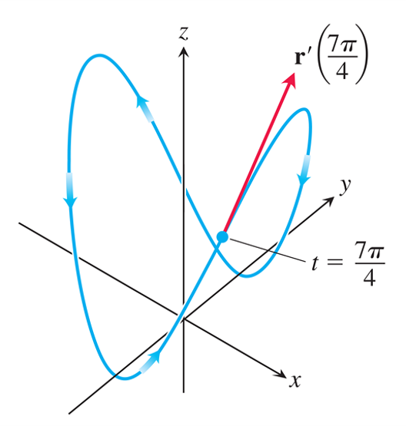
Derivatives and Motion (5 of 7)
The curve and the velocity vector when
for the motion given in the Example.
Notes:
The curve moves in a three-dimensional plane. It is a closed curve along the y z plane, with a point labeled, t = start fraction 7 pi over 4 end fraction. A vector r prime of start fraction 7 pi over 4 end fraction points outward from point t.

Slide 15
Derivatives and Motion (6 of 7)
Example: Find the velocity, speed, and acceleration of a particle whose motion in space is given by the position
vector
Sketch the velocity vector
Solution: The velocity and acceleration vectors at time t are

Slide 16
Derivatives and Motion (7 of 7)
Solution (concluded):
and the speed is
When
we have

Slide 17
Differentiation Rules (1 of 2)
Differentiation Rules for Vector Functions
Let u and v be differentiable vector functions of t, C a constant vector, c any scalar, and f any differentiable scalar function.
1. Constant Function Rule:
2. Scalar Multiple Rules:

Slide 18
Differentiation Rules (2 of 2)
3. Sum Rule:
4. Difference Rule:
5. Dot Product Rule:
6. Cross Product Rule:
7. Chain Rule:

Slide 19
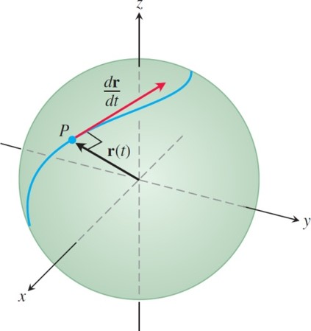
Vector Functions of Constant Length (1 of 2)
If a particle moves on a sphere in such a way that its position r is a differentiable function of time, then
Notes:
Point P is marked on the curve. A position vector, r of t, starts from the origin and points to P. A tangential vector labeled, derivative of r with respect to t, points to the direction of the movement of the particle along the curve. The curve is along the x z plane. The vectors r of t and derivative of r with respect to t are at right angles.

Slide 20
Vector Functions of Constant Length (2 of 2)
If r is a differentiable vector function of t and
the length of
is constant, then

Slide 21
Section 13.2 Integrals of Vector Functions; Projectile Motion

Slide 22
Integrals of Vector Functions (1 of 9)
Definition: The indefinite integral of r with respect to t is the set of all antiderivatives of r, denoted by
If R is any antiderivative of r, then

Slide 23
Integrals of Vector Functions (2 of 9)
Example: To integrate a vector function, we integrate each of its components.

Slide 24
Integrals of Vector Functions (3 of 9)
Definition: If the components of
are integrable over [a, b],
then so is r, and the definite integral of r from a to b is

Slide 25
Integrals of Vector Functions (4 of 9)
Example: As in the previous Example, we integrate each component.

Slide 26
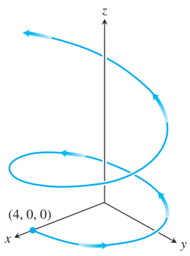
Integrals of Vector Functions (5 of 9)
The path of the hang glider. Although the path spirals around the z-axis, it is not a helix.

Slide 27
Integrals of Vector Functions (6 of 9)
Example: Suppose we do not know the path of a hang glider, but only its acceleration vector
We also know
that initially (at time t = 0) the glider departed from
the point (4, 0, 0) with velocity
Find the
glider’s position as a function of t.

Slide 28
Integrals of Vector Functions (7 of 9)
Solution: Our goal is to find
knowing
The differential equation:
The initial conditions:
Integrating both sides of the differential equation with respect to t gives
We use

Slide 29
Integrals of Vector Functions (8 of 9)
Solution (continued):
The glider’s velocity as a function of time is
Integrating both sides of this last differential equation gives

Slide 30
Integrals of Vector Functions (9 of 9)
Solution (concluded):
We then use the initial condition
The glider’s position as a function of t is

Slide 31
The Vector and Parametric Equations for Ideal Projectile Motion (1 of 5)
Ideal Projectile Motion Equation

Slide 32
The Vector and Parametric Equations for Ideal Projectile Motion (2 of 5)
Example: A projectile is fired from the origin over horizontal ground at an initial speed of 500 meters/seconds
and a launch angle of
Where will the projectile
be 10 seconds later?
Solution: We use the Equation with
to find the projectile’s
components 10 sec after firing.

Slide 33
The Vector and Parametric Equations for Ideal Projectile Motion (3 of 5)
Solution (concluded):
Ten seconds after firing, the projectile is about 3840 meters above ground and 2500 meters downrange from the origin.

Slide 34
The Vector and Parametric Equations for Ideal Projectile Motion (4 of 5)
Height, Flight Time, and Range for Ideal Projectile Motion
For ideal projectile motion when an object is launched from the origin over a horizontal surface
with initial speed
and launch angle α:
Maximum height:

Slide 35
The Vector and Parametric Equations for Ideal Projectile Motion (5 of 5)
Flight time:
Range:

Slide 36
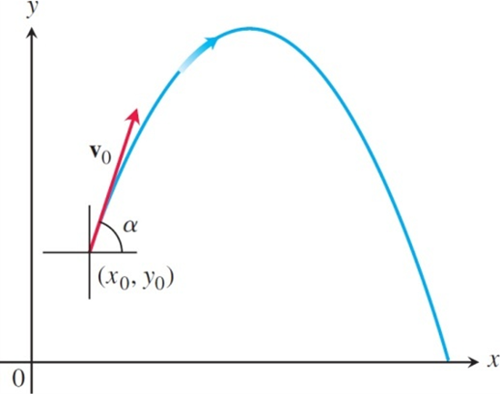
Projectile Motion with Wind Gusts (1 of 8)
The path of a projectile fired from
with
an initial velocity
at an angle of
with the horizontal.
Notes:
The projection curve is a parabolic curve that starts from (x sub 0, y sub 0). The initial velocity vector v sub 0 is acting tangentially from (x sub 0, y sub 0) at an angle of alpha. After reaching its maximum, the projectile then decreases and ends at a point on the x axis.

Slide 37
Projectile Motion with Wind Gusts (2 of 8)
Example: A baseball is hit when it is 3 f t above the ground. It leaves the bat with initial speed of
152 f t/sec, making an angle of
with the
horizontal. At the instant the ball is hit, an instantaneous gust of wind blows in the horizontal direction directly opposite the direction the ball is taking toward the outfield, adding a component of
to the ball’s initial velocity

Slide 38
Projectile Motion with Wind Gusts (3 of 8)
Example (concluded):
(a) Find a vector equation (position vector) for the path of the baseball.
(b) How high does the baseball go, and when does it reach maximum height?
(c) Assuming that the ball is not caught, find its range and flight time.
Solution:
(a) Accounting for the gust of wind, the initial velocity of the baseball is

Slide 39
Projectile Motion with Wind Gusts (4 of 8)
Solution (continued):
The initial position is
Integration of
gives

Slide 40
Projectile Motion with Wind Gusts (5 of 8)
Solution (continued):
A second integration gives
Substituting the values of
into the last
equation gives the position vector of the baseball.

Slide 41
Projectile Motion with Wind Gusts (6 of 8)
Solution (continued):
(b) The baseball reaches its highest point when the vertical component of velocity is zero, or
Solving for t we find

Slide 42
Projectile Motion with Wind Gusts (7 of 8)
Solution (continued):
Substituting this time into the vertical component for r gives the maximum height
That is, the maximum height of the baseball is about 45.2 feet, reached about 1.6 seconds after leaving the bat.
(c) To find when the baseball lands, we set the vertical component for r equal to 0 and solve for t:

Slide 43
Projectile Motion with Wind Gusts (8 of 8)
Solution (concluded):
The solution values are about t = 3.3 sec and
Substituting the positive time into the
horizontal component for r, we find the range
Thus, the horizontal range is about 442 ft, and the flight time is about 3.3 sec.

Slide 44
Section 13.3 Arc Length in Space

Slide 45
Arc Length Along a Space Curve (1 of 8)
Definition: The length of a smooth curve
that is traced
exactly once as t increases from t = a to t = b, is

Slide 46
Arc Length Along a Space Curve (2 of 8)
Arc Length Formula

Slide 47
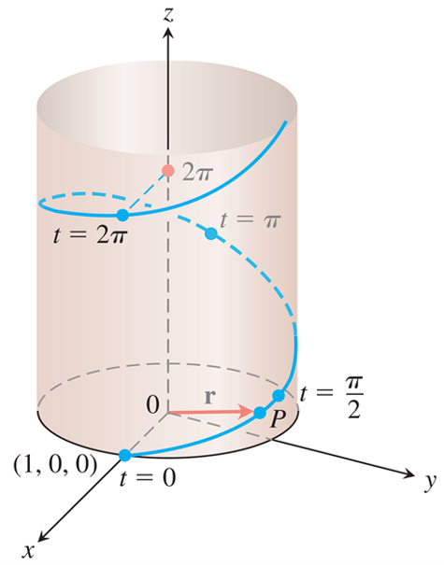
Arc Length Along a Space Curve (3 of 8)
The helix
Notes:
The spiral curve originates from (1, 0, 0) and moves around the z axis on a cylindrical surface in counterclockwise direction. Five points are marked on the curve and they are as follows from bottom to top. The first point at (1, 0, 0) is labeled, t = 0. The second point is labeled, P, with a vector r pointing to it from the origin. The third point is slightly above point P and is labeled, t = start fraction pi over 2 end fraction. The fourth point is at t = pi. The fifth point is at t = 2 pi.

Slide 48
Arc Length Along a Space Curve (4 of 8)
Example: A glider is soaring upward along
the helix
How
long is the glider’s path from
Solution: The path segment during this time corresponds to one full turn of the helix. The length of this portion of the curve is

Slide 49
Arc Length Along a Space Curve (5 of 8)
Solution (concluded):
This is
times the circumference of the circle
in the x y-plane over which the helix stands.

Slide 50
Arc Length Along a Space Curve (6 of 8)
Arc Length Parameter with Base Point

Slide 51
Arc Length Along a Space Curve (7 of 8)
Example: This is an example for which we can actually find the arc length parametrization of a
curve. If
the arc length parameter along
the helix
from
to t is

Slide 52
Arc Length Along a Space Curve (8 of 8)
Example (concluded):
Solving this equation for t gives
Substituting into the position vector r gives the following arc length parametrization for the helix:

Slide 53
Speed on a Smooth Curve
The Fundamental Theorem of Calculus tells us that s is a differentiable function of t with derivative

Slide 54
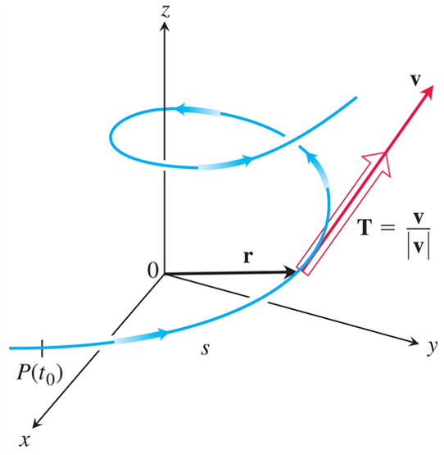
Unit Tangent Vector (1 of 3)
We find the unit tangent vector T by dividing v by
its length
Notes:
The spiral curve moves in counterclockwise direction. A vector from the origin meets the curve at a point P of t sub zero in the x y plane. Point p of t sub zero is labeled, base point. Another vector, r, from the origin, meets the curve at point P of t. The arrows along the curve indicate that the curve is moving upward, along the z axis. s of t is the distance between P of t and P of t sub 0.

Slide 55
Unit Tangent Vector (2 of 3)
Example: Find the unit tangent vector of the curve
representing the path of the glider in a previous Example.
Solution: We found
and

Slide 56
Unit Tangent Vector (3 of 3)
Solution (concluded):
Thus,

Slide 57

Copyright
This work is protected by United States copyright laws and is provided solely for the use of instructors in teaching their courses and assessing student learning. Dissemination or sale of any part of this work (including on the World Wide Web) will destroy the integrity of the work and is not permitted. The work and materials from it should never be made available to students except by instructors using the accompanying text in their classes. All recipients of this work are expected to abide by these restrictions and to honor the intended pedagogical purposes and the needs of other instructors who rely on these materials.

